Slide 1
keylogger
CAPSTONE PROJECT
Presented By:
1. Pradeep C-P.S.V Collage of Engineering and Technology-Computer Science and Engineering

Slide 2
OUTLINE
Problem Statement
Proposed System/Solution
System Development Approach
Algorithm & Deployment
Result (Output Image)
Conclusion
Future Scope
References

Slide 3
Problem Statement
In the context of cybersecurity, the threat of keyloggers, malicious software capable of covertly recording keystrokes, poses a significant risk to user privacy and data security. Traditional security measures often struggle to detect and mitigate keylogger attacks effectively, leading to the need for innovative solutions to combat this pervasive threat.

Slide 4
Proposed Solution
The proposed system aims to develop a comprehensive keylogger application utilizing Python and Tkinter GUI toolkit. The solution will encompass the following components:
Event Handling:
Implement event handlers to capture key press and release events.
Record pressed, held, and released keys to monitor user activity effectively.
File Management:
Develop functions to save keystrokes in both text and JSON formats for comprehensive logging.
Ensure proper handling of files to store captured keystrokes securely and efficiently.
Graphical User Interface (GUI):
Design a user-friendly interface using Tkinter, allowing users to start and stop the keylogging process with ease.
Provide clear visual feedback to indicate the status of the keylogger (running or stopped).
Control Mechanism:
Enable users to initiate and halt the keylogging process through dedicated buttons in the GUI.
Implement global variables and flags to manage the keylogging state and ensure accurate capture of keystrokes.
Deployment:
The keylogger application can be deployed on any system with Python and Tkinter installed. The deployment process involves:
Running the Python script containing the keylogger code.
Interacting with the graphical user interface to start or stop the keylogging process.
Monitoring the output files (key_log.txt and key_log.json) to view captured keystrokes.

Slide 5
System Approach
Importing Libraries: The necessary libraries such as tkinter for GUI, pynput for keyboard monitoring, and json for handling JSON files are imported.
Global Variables: Global variables are initialized to manage the keylogging process.
Event Handlers: Functions on_press and on_release are defined to handle keyboard events. They record pressed, held, and released keys.
File Handling: Functions generate_text_log and generate_json_file are created to save keystrokes in text and JSON formats, respectively.
GUI Setup: The Tkinter-based GUI is created with buttons for starting and stopping the keylogger.
Keylogger Control: Functions start_keylogger and stop_keylogger are defined to initiate and halt the keylogging process.
Main Loop: The Tkinter main loop is executed to run the GUI application.

Slide 6
Algorithm & Deployment
Algorithm:
Initialize global variables, including flag and keys_used list.
Define event handlers for key press and release.
Implement functions to save keystrokes in text and JSON formats.
Create GUI components and event handlers for starting and stopping the keylogger.
Execute the main Tkinter loop to run the GUI application.
Deployment:
The code can be executed using any Python IDE or command-line interface.
Ensure the necessary libraries (tkinter, pynput) are installed.
Run the script, and the GUI for the keylogger application will appear.

Slide 7


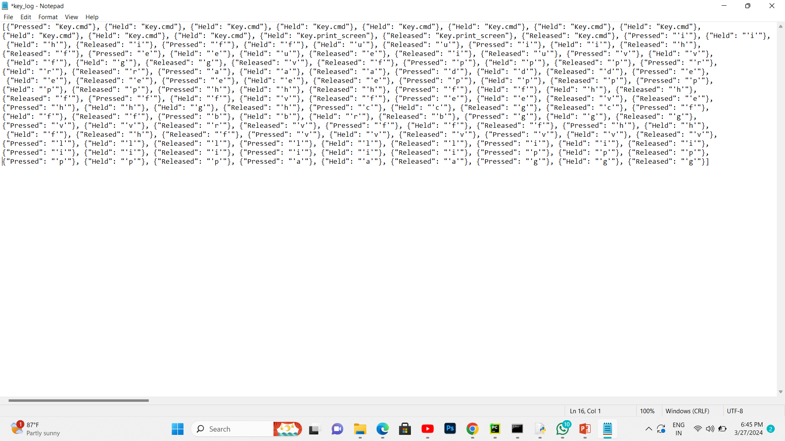

Result

Slide 8
Conclusion
The implemented keylogger provides a basic yet functional solution for capturing keystrokes and saving them for analysis. It demonstrates the feasibility of developing a keylogging application using Python and Tkinter GUI toolkit. However, further enhancements are necessary to address advanced features and security considerations.

Slide 9
Future scope
Enhancing GUI: Improve the user interface for better usability and aesthetics.
Advanced Logging: Implement features for logging additional information such as timestamps and application context.
Security Enhancements: Integrate encryption and authentication mechanisms to secure the logged data.
Cross-Platform Compatibility: Ensure the keylogger works seamlessly across different operating systems.
Performance Optimization: Optimize the code for efficiency and minimize resource usage.

Slide 10
References
Tkinter Documentation: https://docs.python.org/3/library/tkinter.html
Pynput Documentation: https://pynput.readthedocs.io/en/latest/
Python JSON Documentation: https://docs.python.org/3/library/json.html

Slide 11
THANK YOU

